Slide 1

Database Management System
Presented by the Mavs Group:
Joe Cremeens
Erik Eiler
Shafiq Janish
Christopher Kozeny
John Manzo
Notes:
Joe

Slide 2

Overview
Introduction
System Purpose
Expected Benefits
Creating the System
Development Methodology
System Structure
System Demonstration
Using Forms
Generating Reports
What Was Learned?
Conclusion
Questions & Answers
Notes:
Joe

Slide 3
System Purpose
Add efficiencies & quality controls to business operations
Centralize all business data into a single application
Eliminate manual invoicing, recordkeeping, and inventory management
Reduce clerical and accounting errors
Reference any client, appointment, or purchase in seconds
Add intelligence to business operations
Track appointments, payments, purchases, and profit/loss performance
Add permanence to valuable business data
Retain all records for clients, appointments, purchases, and vendors
Recover all data from any type of system failure
Notes:
Cj

Slide 4
Expected Benefits
Less time spent on administration
New efficiencies mean more time can be spent on billable activities
Improved client & vendor relations and management
Fewer client billing errors & improved collection rates
Fewer late-fees paid to vendors
Fewer missed appointments
More professionalism = more repeat and referral business
Measurable performance factors
Fine-tune operations by focusing on what works and what doesn’t
Notes:
Cj

Slide 5
Expected Benefits (cont.)
Quantified tangible benefits over five years
Additional $5,100 per year after one year of operation
Two additional $125 appointments per month (referrals/repeats)
Less $50 per month in vender payment late fees (purchase tracking)
Administration time savings = one additional $125 job per month
Time to breakeven post-implementation: 1.86 years
Factors in upfront analysis, design, & development costs ($5,970)
Factors in ongoing maintenance & upgrades costs ($1,400/year)
Return on Investment (ROI) after five years: 84%
Notes:
Cj

Slide 6
Development Methodology
Phased approach to system development
System feasibility ensured early and cost/time overruns prevented
System includes comprehensive technical & user documentation
Planning, analysis, and design
Thorough assessment of business needs
Detailed feasibility analysis to gauge benefits & risks
Scrutinizing designs to uncover problems before they become bugs
Archiving all findings and designs for future developers
Development, implementation, training, and maintenance
System developed adhering to already established guidelines
Plans crafted to install the system, train users, and conduct maintenance
User manual to explain using the system and recovering from problems
Notes:
John

Slide 7
System Structure
The power of interconnecting categorized, persistent data
Business transactions are correctly & permanently linked to all concerned parties
Record updates do not sever transaction-party links
All historical information is archived and accessible
Inventory quantity-on-hand updates dynamically with each appointment & purchase
Client
System Reports
Appointments include client & inventory information
Invoices include appointment details & all unpaid balances
Purchases include inventory items & the selling vendors
Profit/Loss reports include appointment & purchase data
Appointment
Inventory
Purchase
Vendor
Notes:
John

Slide 8
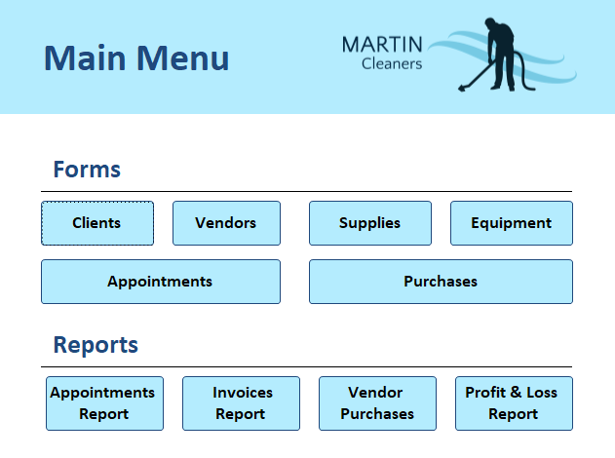
System Demonstration
Notes:
Erik

Slide 9
What Was Learned?
Rigorous time management is key to meeting deadlines
Start early so the team can adapt to workplan changes on-the-fly
Communicate progress & problems so the team can make needed adjustments
Teamwork is dreamwork
Peer and PM feedback loops catch problems before they become errors
Leverage individual members’ strengths when assigning tasks
Set a high bar for quality assurance
Sweat the small stuff—attention to little details leads higher overall standards
Allow constructive criticism to empower not demoralize
Write for the reader & design for the user
The better you know your audience, the better understood your writing will be
Be aware of the usability gap between developers & users—design for users
Notes:
Shafiq

Slide 10
Conclusion
The system is designed to reduce administrative errors & workload
Proper usage of the system can help grow the business
The development process emphasized benefits & minimized risks
Tangible benefits & costs have been identified & quantified
System structure enforces proper operation & accurate reporting
Lessons learned speak to self-discipline, collaboration, & client focus
Notes:
Joe

Slide 11
Questions & Answers
?

Slide 12
Database Management System
Presented by the Mavs Group:
Joe Cremeens
Erik Eiler
Shafiq Janish
Christopher Kozeny
John Manzo

